Slide 1
Hospital Database System
150130040 – Utku Anıl Saykara
150130904 – Orhan Kurto
040130240 – Bilal Can

Slide 2
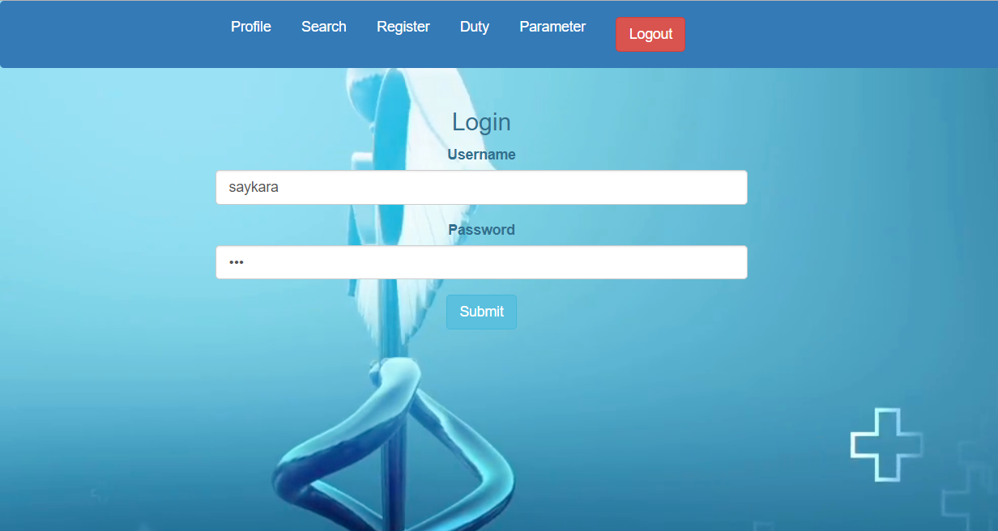
Login

Slide 3
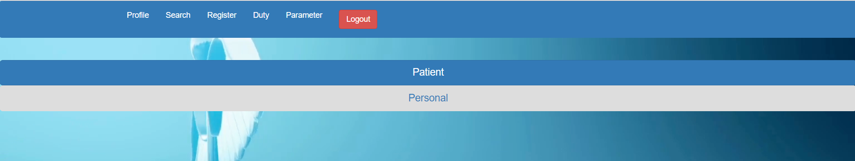
Adding User

Slide 4
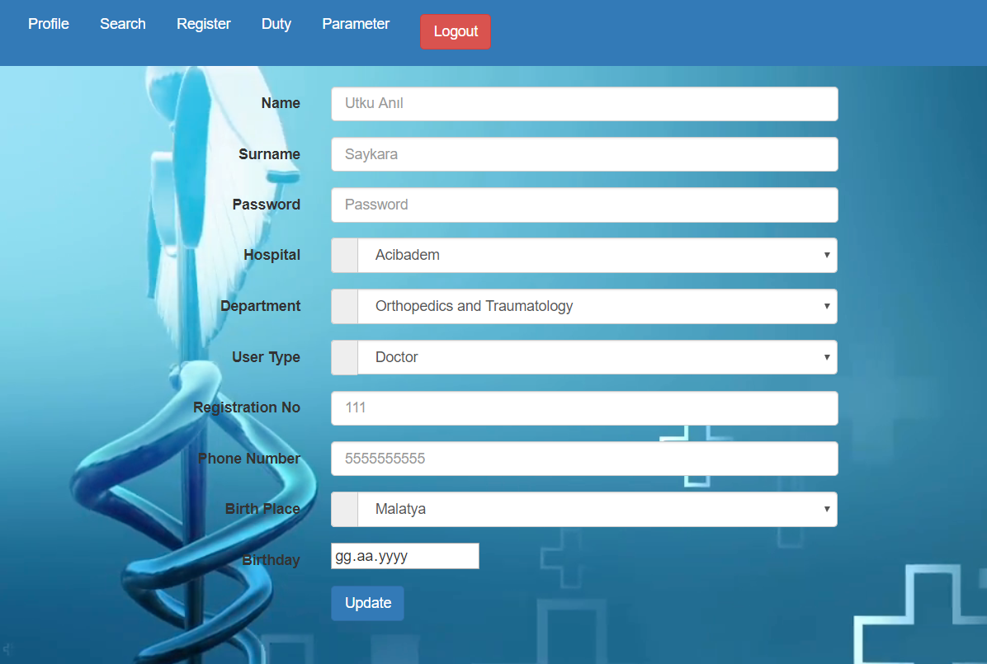
Adding Personnel

Slide 5
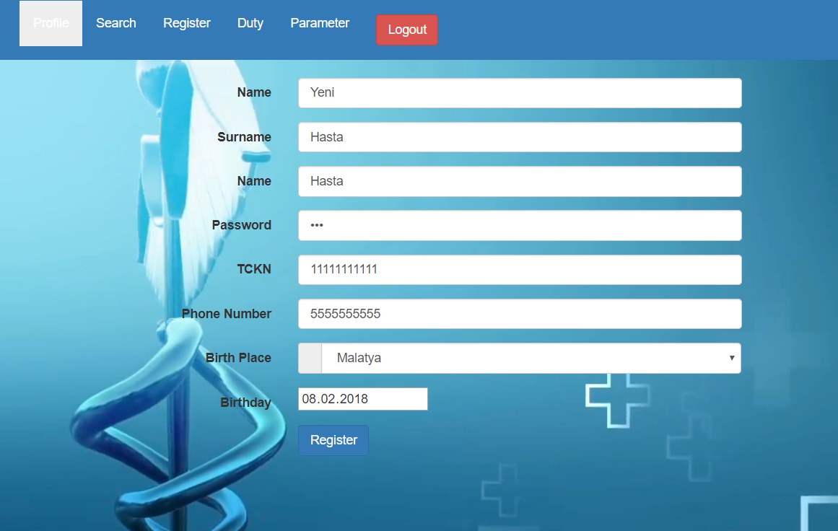
Adding Patient

Slide 6
Updating Personnel’s Info

Slide 7
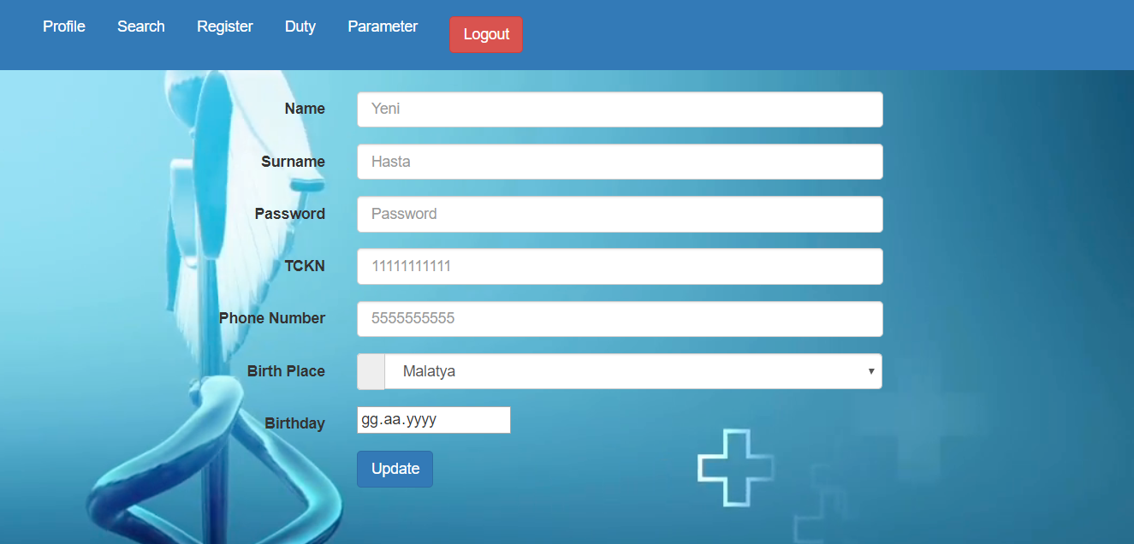
Updating Patient’s Info

Slide 8
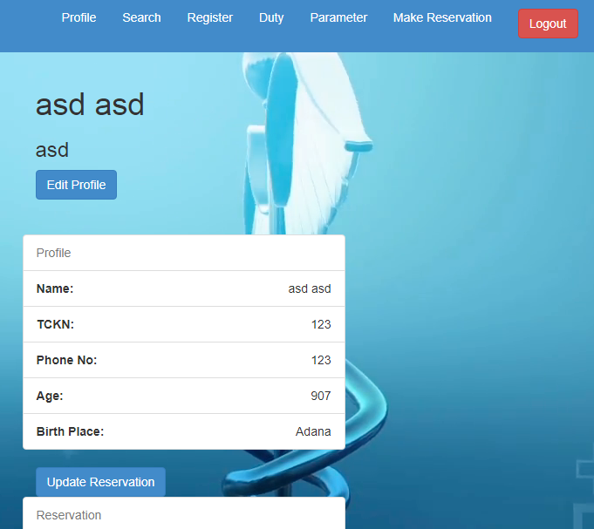
Profile Page for Patient

Slide 9
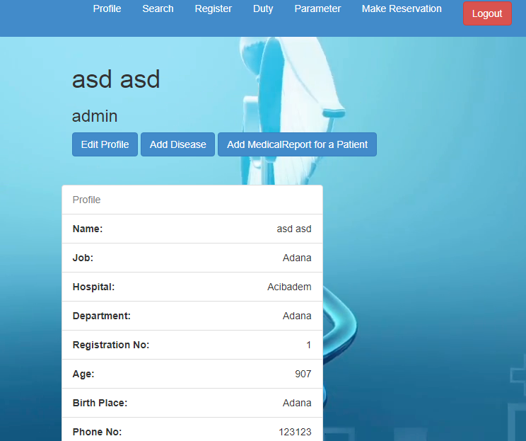
Profile Page for Admin and Personnels

Slide 10
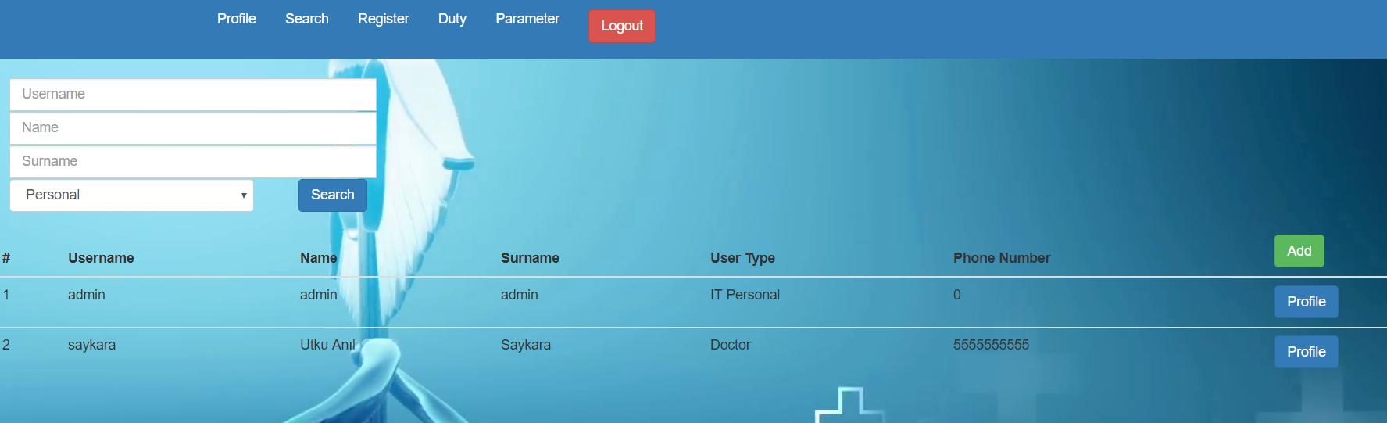
Search for Users

Slide 11
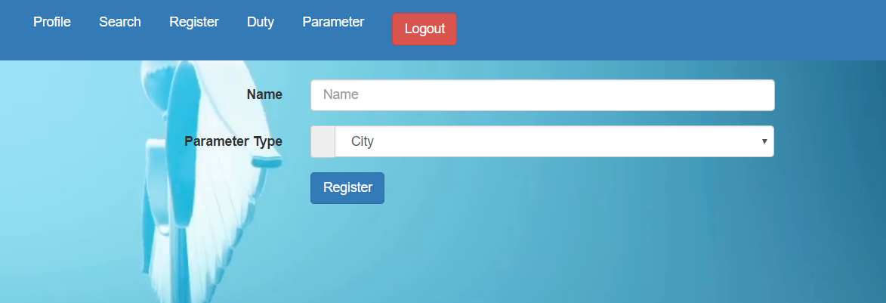
Adding a Parameter

Slide 12
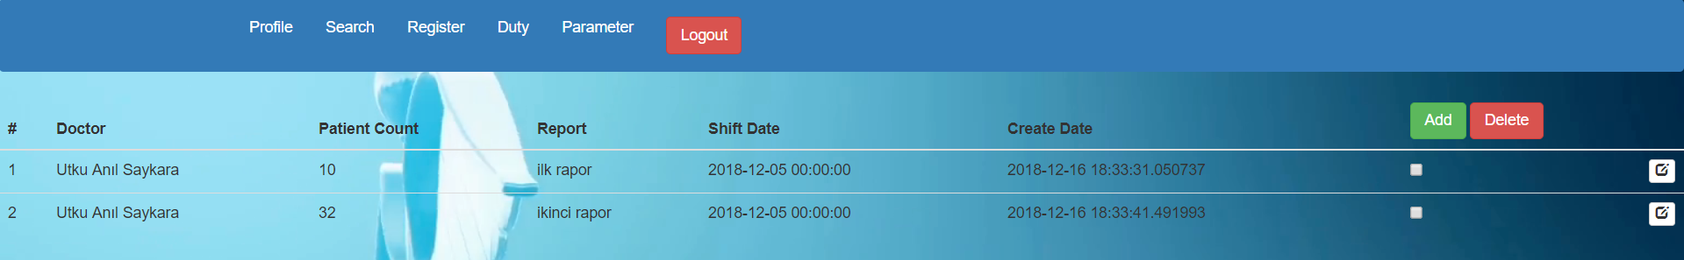
Duty List

Slide 13
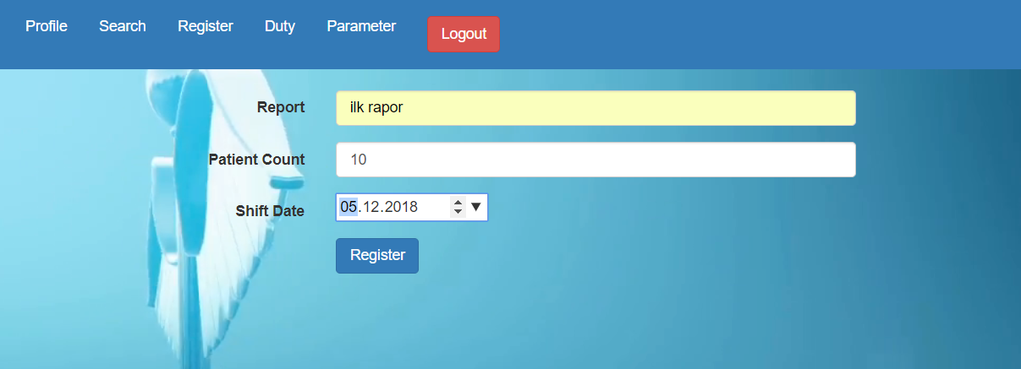
Adding Duty

Slide 14
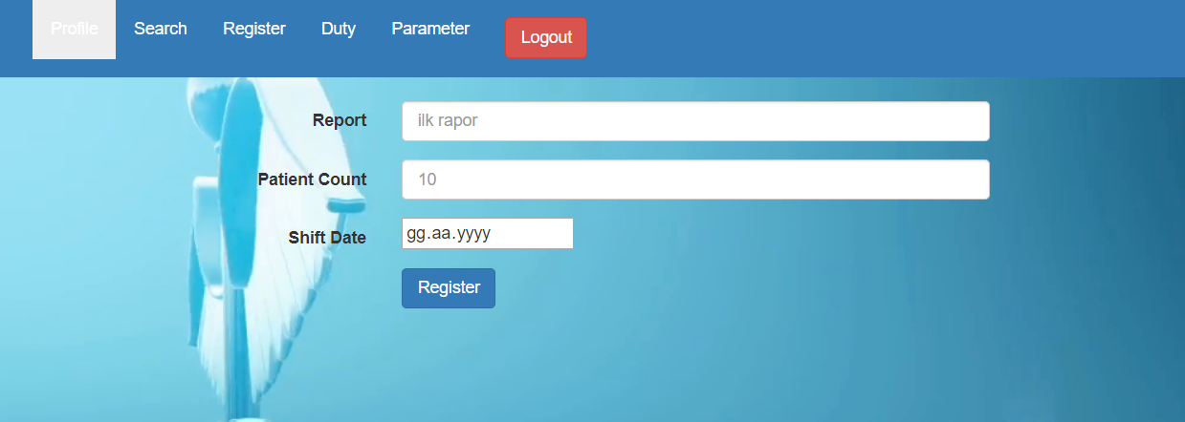
Arranging Duty

Slide 15
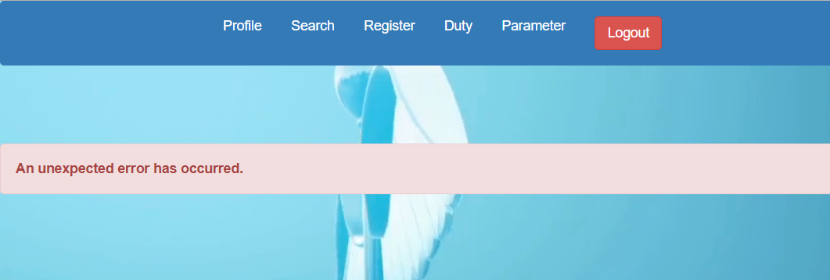
Error Page

Slide 16
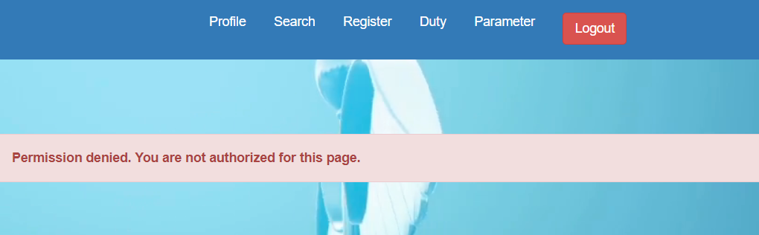
Permission denied page for Users

Slide 17
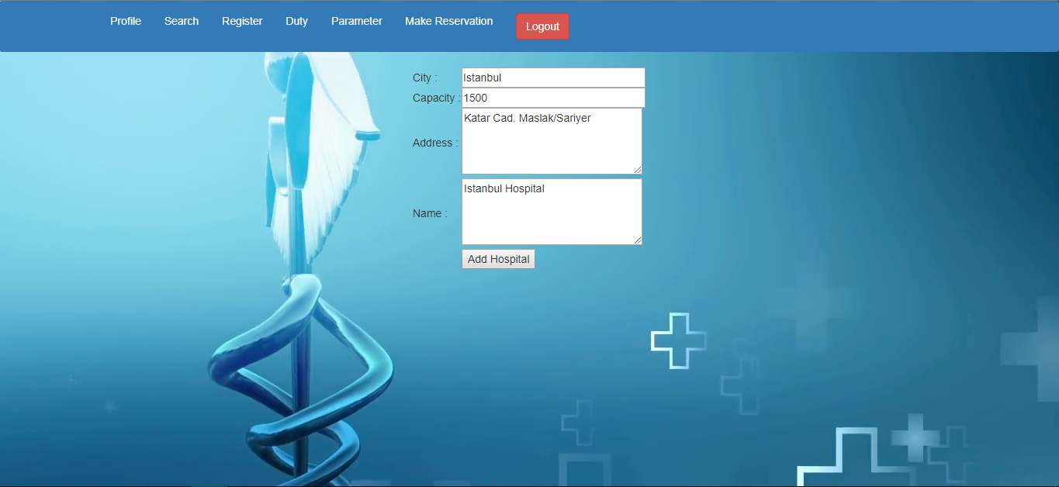
Adding Hospital

Slide 18
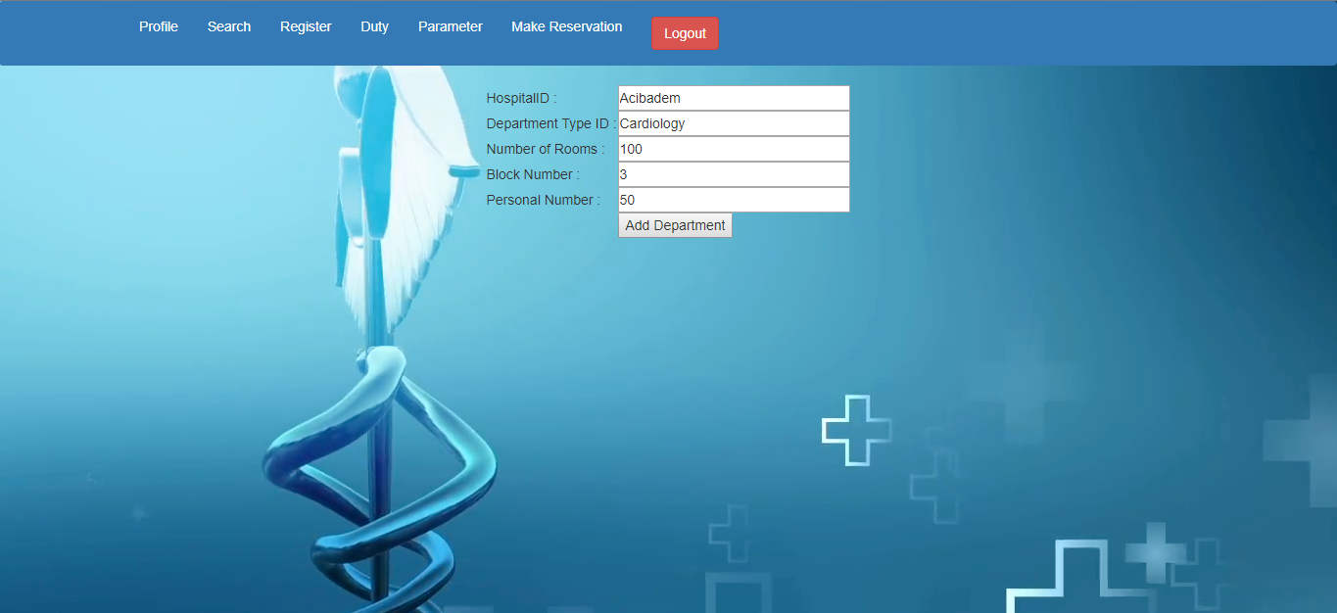
Adding Department

Slide 19
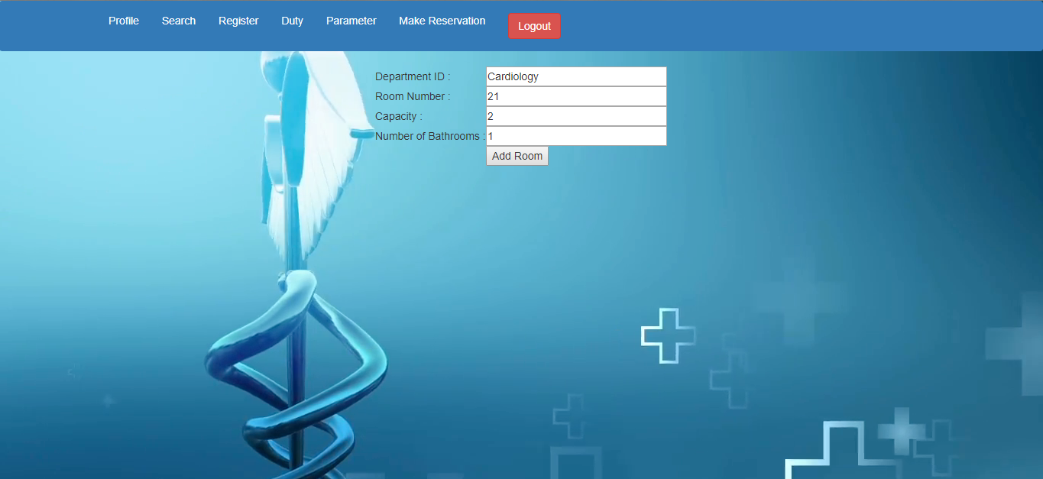
Adding Room

Slide 20

Updating Hospital’s Info

Slide 21

Updating Department’s Info

Slide 22

Updating Rooms

Slide 23
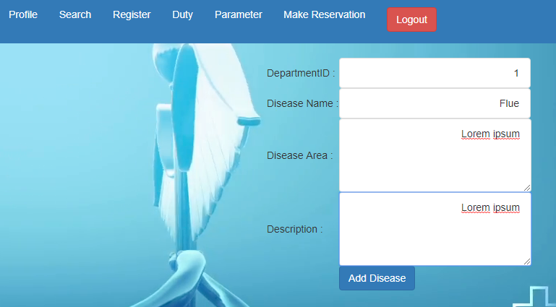
Disease Adding

Slide 24
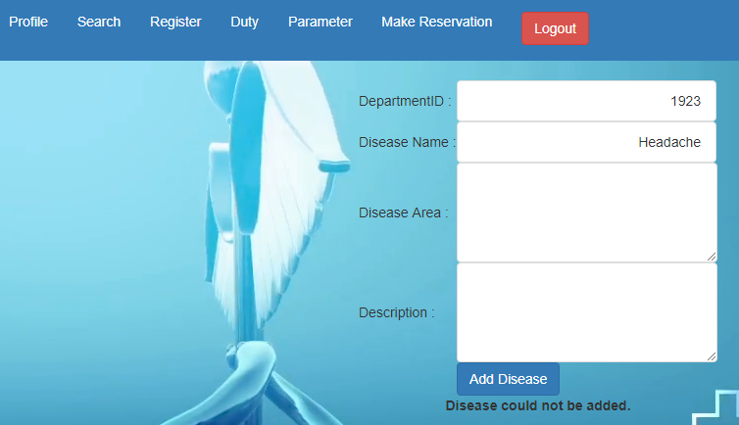
Successful Disease Adding or Error

Slide 25
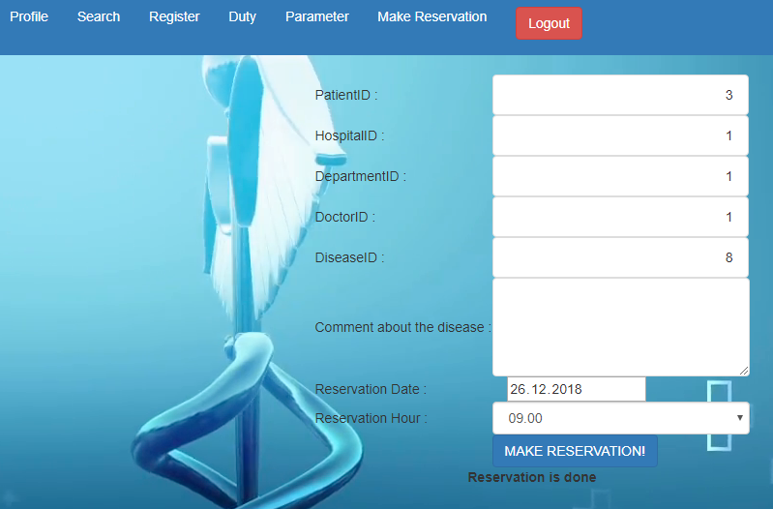
Making A Reservation

Slide 26
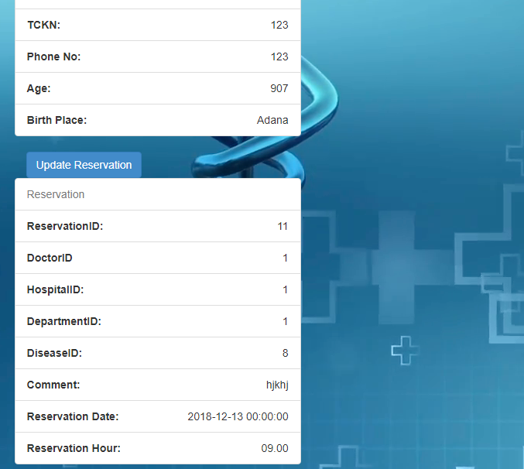
Updating A Reservation is Available from the Patient Profile Page

Slide 27
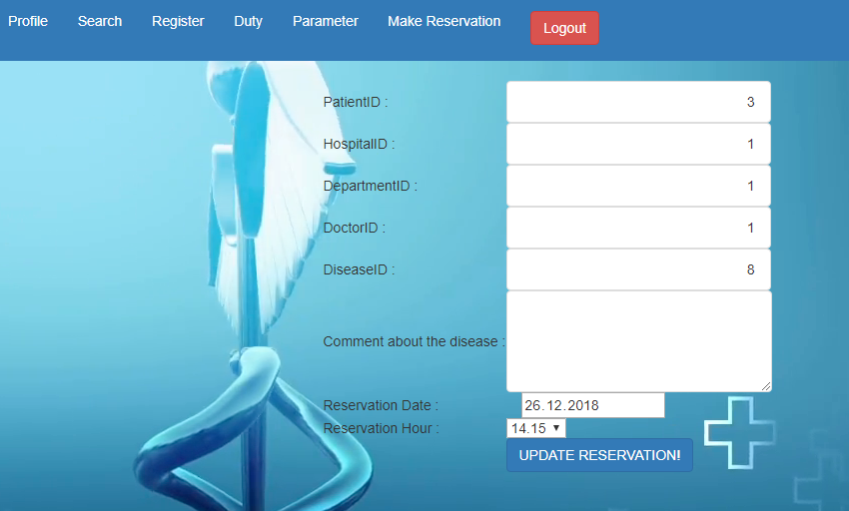
Updating A Reservation (/updatereservation/reservationid)

Slide 28
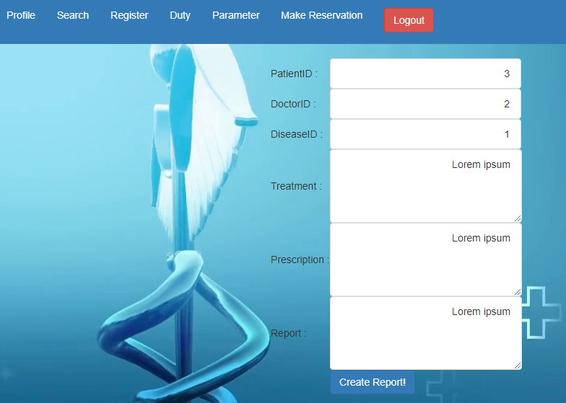
Adding A Medical Report

Slide 29
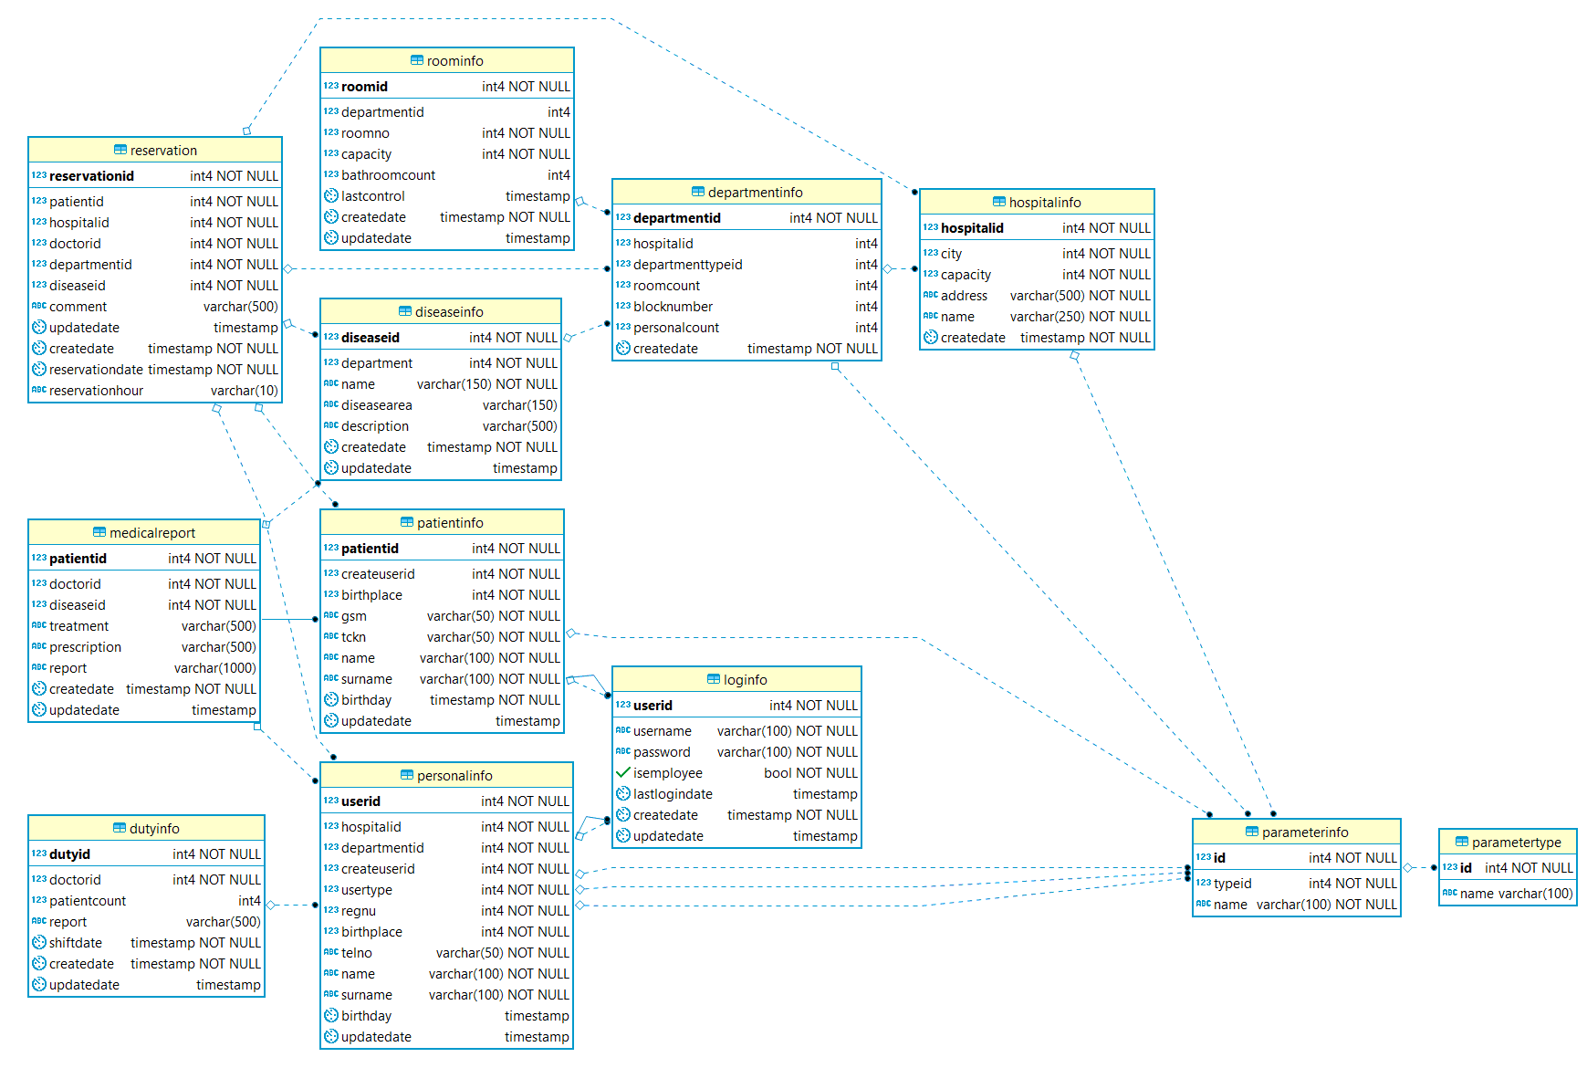
Database Diyagramı

Slide 30
THANKS FOR LISTENING…

